Slide 1
Topic: Percentages
EQ: How do I convert between fractions, decimals and percentages?
Instructions:
1. Read slide 2- add new topic to contents page and rule up 3-column notes ( see what I mean by viewing slide 3)
2. Slides 3-5 are your notes, you will need to have the PowerPoint in slideshow mode and click through all of the notes on each slide
3. Complete activity on slide 6. Put this in on your LHS of your interactive notebook. Hide the answers if you can and only check at the end.
4. Write the notes that are on slide 7. This are important.
5. Complete the activity on slide 8 Put this in on your LHS of your interactive notebook. Hide the answers if you can and only check at the end.
6. Complete the activity on slide 9 Put this in on your LHS of your interactive notebook. Hide the answers if you can and only check at the end.
7. Work through the activity on slide 10 and submit a photo of your INB into the submission folder

Slide 2
Topic: Percentages
EQ: How do I convert between fractions, decimals and percentages?
Rule up for 3-column notes! ☺
This is a new topic so add this to your contents page

Slide 3
Topic: Percentages
EQ: How do I convert between fractions, decimals and percentages?
Question:
Explanation:
Example:
How do I convert a fraction into a decimal?
Divide the numerator (the top number) by the denominator (the bottom number)
$\frac{1}{2}$ → 1 ÷ 2 = 0.5
$\frac{3}{4}$ → 3 ÷ 4 = 0.75
$\frac{1}{3}$ → 1 ÷ 3 = 0.33…

Slide 4
Think-Pair-Share
In Pairs try converting these 4 fractions into decimals
Be ready to share your answers with the class!
$\frac{1}{4}$
$\frac{7}{8}$
#teamwork
$\frac{2}{3}$
$\frac{5}{4}$
Notes:
¼ = 0.25 = 25%
7/8 = 0.875 = 87.5%
2/3 = 0.667 = 66.7%
5/4 = 1.25 = 125%

Slide 5
Topic: Percentages
EQ: How do I convert between fractions, decimals and percentages?
Question:
Explanation:
Example:
Now I have a decimal how do I convert it into a percentage?
To convert a decimal into a percentage it needs to be multiplied by 100.
0.5 → 0.5 x 100 = 50%
0.75 → 0.75 x 100 = 75%
0.33… → 0.33… x 100 = 33.33%

Slide 6
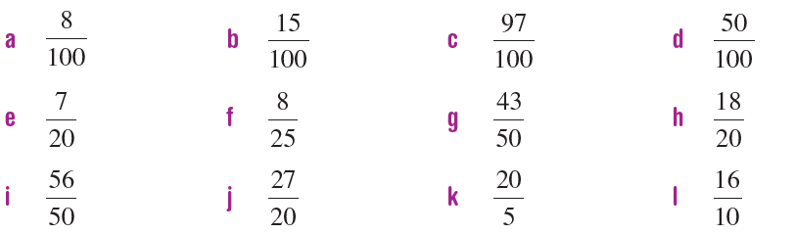
Left-Hand-Side Task 1
Check your answers
8%
15%
97%
50%
35%
32%
86%
90%
112%
135%
400%
160%
Convert these fractions into percentages by first converting them into decimals:

Slide 7
Topic: Percentages
EQ: How do I convert between fractions, decimals and percentages?
Question:
Explanation:
Example:
The symbol, %, means ‘per cent’, which means “out of 100”.
Therefore, 75% means 75 out of 100.
We can write percentages as fractions by changing the % sign to a denominator of 100 (meaning out of 100)
What is a percentage?
50% → 50 out of 100 → $\frac{50}{100}$
75% → 75 out of 100 → $\frac{75}{100}$
Can we simplify these fractions?
Notes:
We can simplify them to ½ and ¾

Slide 8
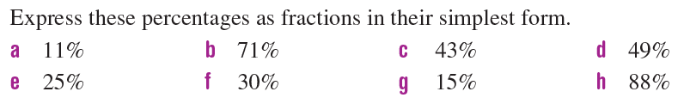
Left-Hand-Side Task 2
Check your answers!
a. 11/100 b. 71/100 c. 43/100 d. 49/100 e. 1/4 f. 3/10 g. 3/20 h. 22/25

Slide 9
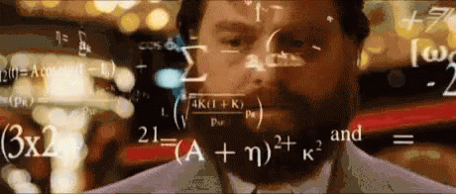
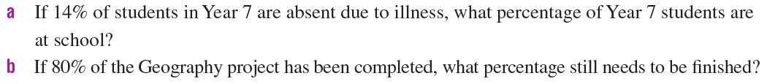
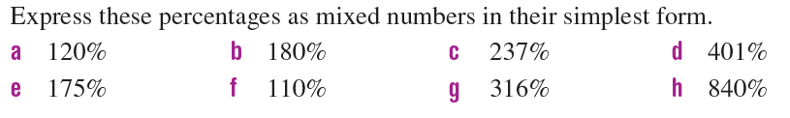
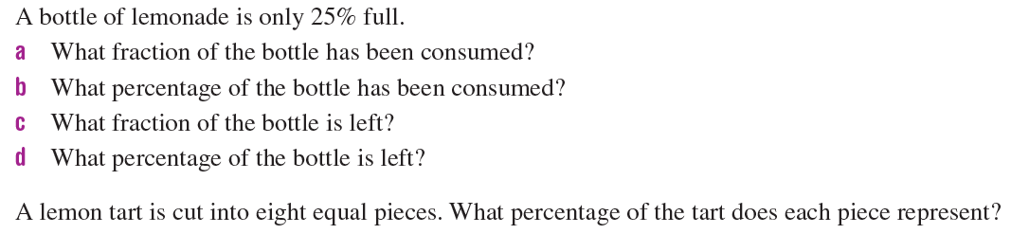
Left-Hand-Side Task 3
Notes:
1a. 86% 1b. 20% 2a. 120/100=12/10=6/5=1 1/5 2b. 180/100=18/10=9/5=1 4/5 2c. 237/100=2 37/100 2d. 401/100=4 1/100 2e. 175/100=35/20=7/4=1 ¾
2f. 110/100=11/10=1 1/10 2g. 316/100=79/25=3 4/25 2h. 840/100=84/10=8 4/10=8 2/5
3a. ¾ 3b. 75% 3c. ¼ 3d. 25%
4. 12.5%

Slide 10
Worksheet Task 4
1. Complete T1W9_Lesson 1_FractionsDecimalsPercentage worksheet
2. Check using T1W9_Lesson 1_FractionsDecimalsPercentage worksheetANSWERS
3. Take a photo of your INB and upload it to the submission folder, T1W9_Lesson 1_FractionsDecimalsPercentages

